Slide 1
FlexPatch Design Notes
5/29/2021

Slide 2
Design requirements: Forearm (or lower leg)
Number of electrodes (channels): 32
Arrangement: 4x8 grid
Interelectrode spacing: 10-30 mm
Ribbon cable length
Coverage area: ~150 mm x ~150 mm
~60% of distance from elbow to wrist x width of arm at widest point
electrode footprint should be tapered from elbow to wrist
Anchoring
Flex substrate needs to be anchored to the arm; start with elastic straps
Multiple patches will be tiled together to cover the forearm or lower leg

Slide 3

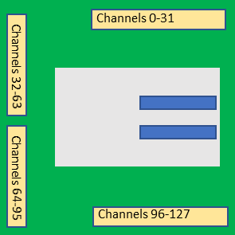
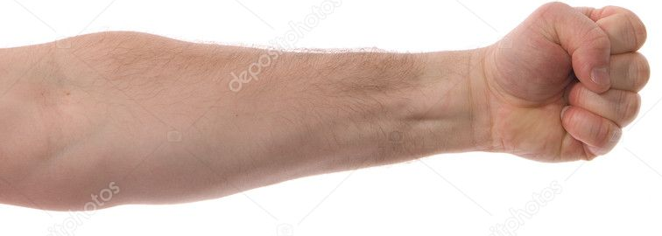
Concept 1
Elastic straps
EMG patch
4 x 32-channel patches
Rectangular grid (e.g. 4x80); no taper

Slide 4
Concept 2
Elastic straps
EMG patch
64-channel patch on anterior (palmar) side and 32-channel patch on posterior side
32-channel patch
4x8 grid
64-channel patch
will mate with MB via 2x32-channel ZIF connectors
Tapered to accommodate extra width near elbow

Slide 5
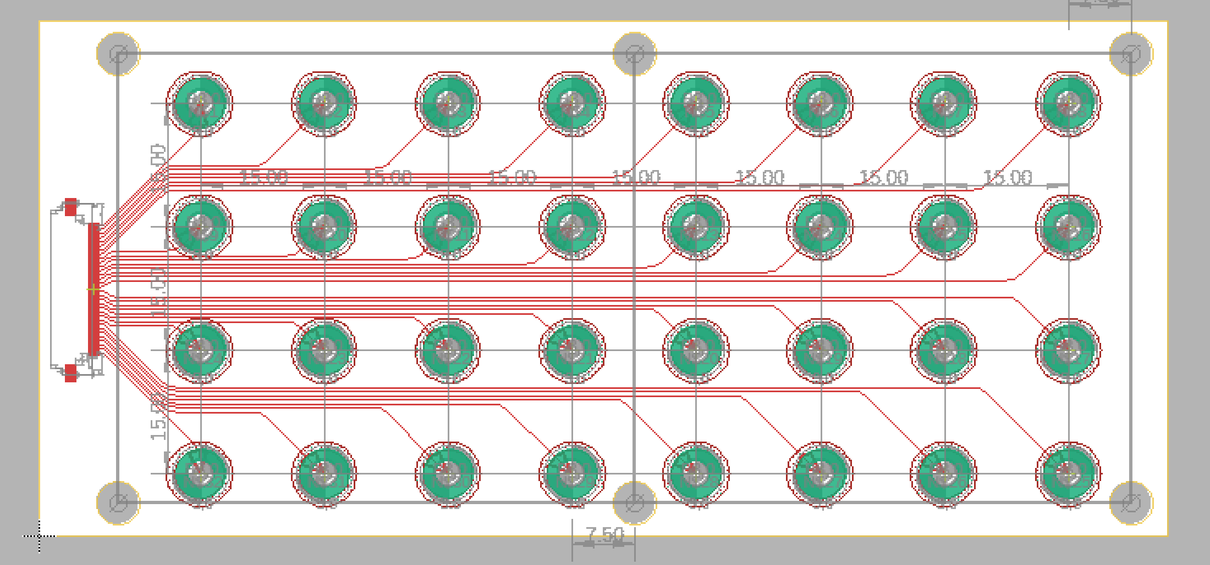
Anchoring straps
.75” or 1” elastic straps (Amazon)
Attachment to flex substrate (options)
Preferred: boards built with slits cut into edges; stiffeners will need to be added to the edges
Alternative: screws or rivets attached to holes in flex
Other ideas?
Straps should provide tension to hold the electrodes against the skin

Slide 6
Patch Design Changes
Increase electrode spacing to 20mm
Add features for anchoring straps
Add ribbon cable to extend edge connector ~10 cm (make some measurements on your own arm to estimate distance)
NOTE: we will need 4 different patch designs as shown at right

